Slide 1
Mean Shift Clustering

Slide 2
Mean Shift Clustering — Executive Summary
Definition: A powerful, non-parametric clustering technique that groups data by locating density peaks.
Key Advantage: Unlike K-Means, it does not need a predefined number of clusters (K) — automatically adapts to data.
Best for: Complex, non-linear, irregular-shaped data where true cluster count is unknown.
Limitation: Computationally intensive for large/high-dimensional data; sensitive to bandwidth parameter.

Slide 3
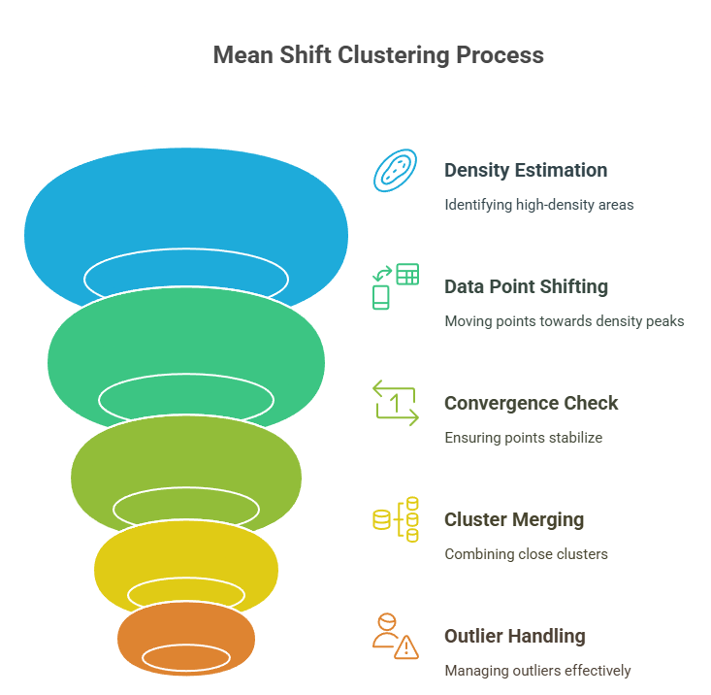

Slide 4
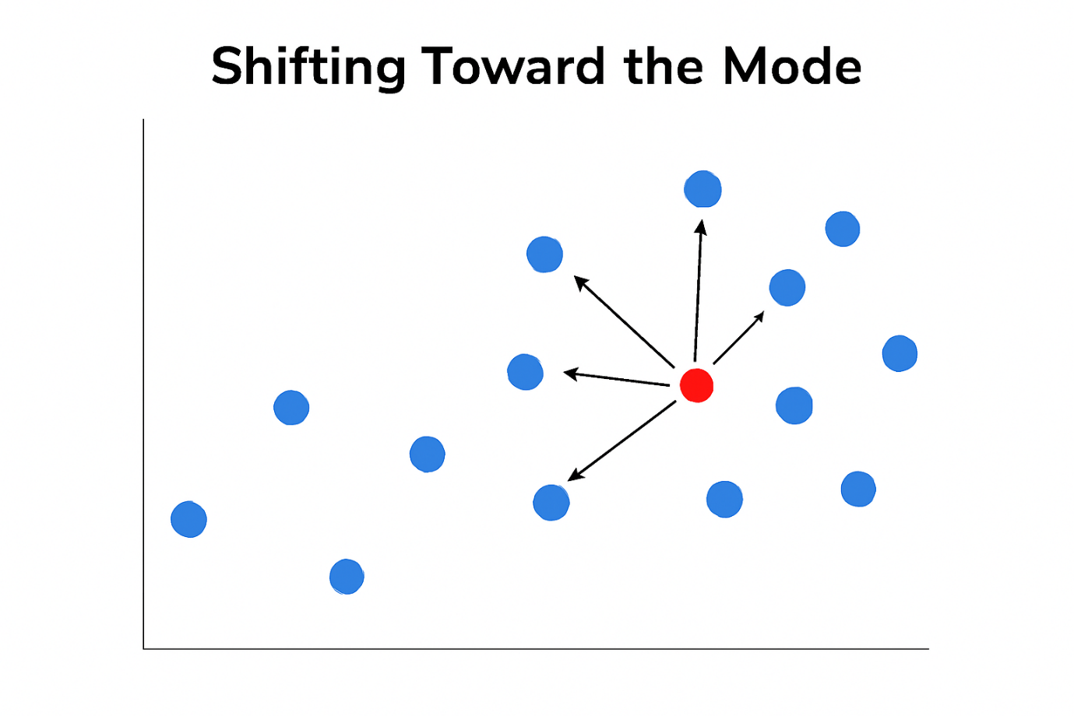
Core Concepts
Non-Parametric: No need to predefine cluster numbers.
Mode: Clusters form around density peaks (modes) — areas where data points are most concentrated.
Kernel Density Estimation (KDE): Uses a kernel (e.g., Gaussian) to estimate density.
Iterative Shifting: Points shift toward modes until convergence.
Dynamic Centroids: Cluster centers evolve, unlike fixed centers in K-Means.

Slide 5
How It Works — Step by Step
Define Kernel & Bandwidth
Kernel weights nearby points.
Bandwidth sets neighborhood radius (key parameter). 2️⃣ Iterative Shifting
Each point shifts toward the mean of neighbors.
Repeat until shifts are negligible. 3️⃣ Form Clusters
Points that converge to the same mode → one cluster.
Prune close clusters; handle outliers.

Slide 6
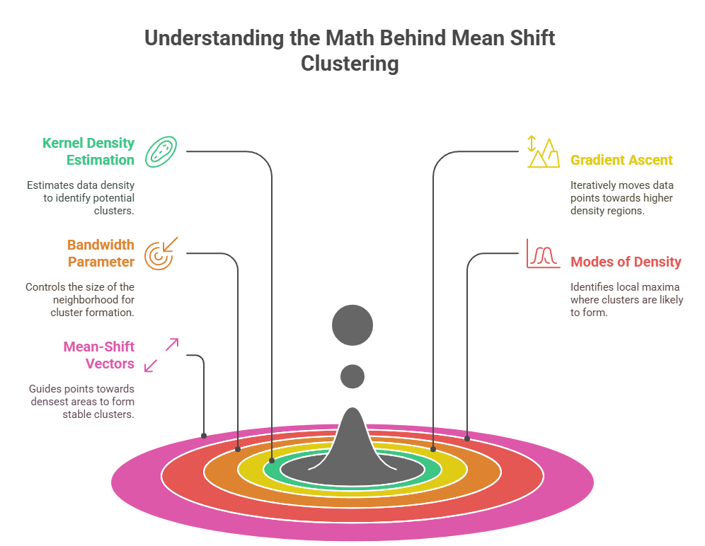
Mathematical Intuition
KDE: Smooths data, reveals density peaks.
Gradient Ascent: Points move in the direction of maximum density increase.
Bandwidth Impact: Controls cluster size & count — too small → many tiny clusters; too large → merges distinct clusters.
Modes: Final clusters = local maxima of the density function.

Slide 7
Mean Shift vs K-Means
Feature | K-Means | Mean Shift
Predefined K | Required | Not required — finds clusters automatically
Cluster Shape | Assumes spherical | Handles irregular/complex shapes
Data Fit | Best for uniform, well-separated data | Adapts to varying densities & non-linear data
Flexibility | Less flexible | Highly flexible & robust
Best For | Known clusters | Exploratory analysis, unknown cluster count

Slide 8
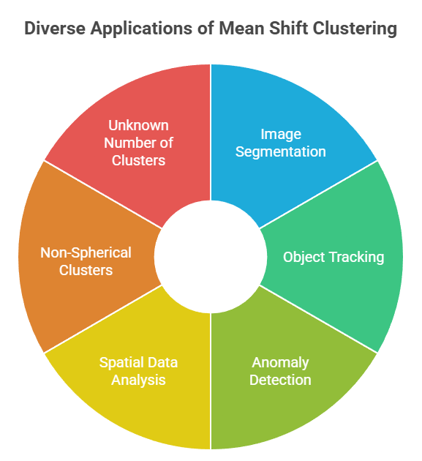
Key Applications
Image Segmentation: Divides images into meaningful regions (e.g., medical imaging, autonomous vehicles).
Object Tracking: Tracks moving objects using high-density regions.
Anomaly Detection: Finds outliers in low-density areas (e.g., fraud detection).
Spatial Data Analysis: Clusters geo-spatial data (e.g., urban planning, weather, real estate).
Unknown Number of Clusters: automatically finds the number of clusters based on data density
Non-spherical clusters: clusters of any shape by adapting to the data’s natural distribution

Slide 9
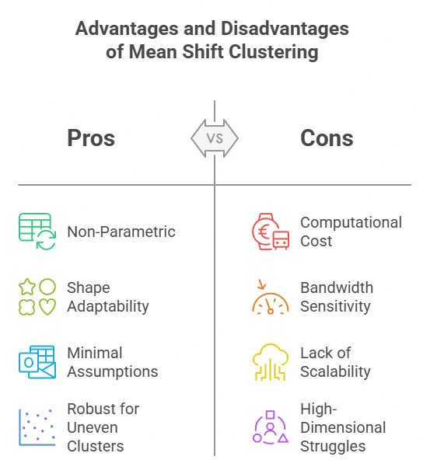
Pros and Cons

Slide 10
When to Use Mean Shift
Best for:
Small-to-medium datasets.
Unknown or irregular clusters.
Exploratory data analysis.
Avoid for:
Very large datasets (consider K-Means or DBSCAN instead).
High-dimensional data without pre-processing.

Slide 11
Thankyou

